Slide 1


YOUR QUALITY PARTNER FOR SOFTWARE SOLUTIONS
Robot framework
Mac Automation - (Appium for Mac)
Dong Nguyen
TMA Solutions
www.tmasolutions.com

Slide 2

Agenda
Duration: 3 hours
Prerequisites:
Have experiences on Robot Framework, Selenium and Python
Running: Mac OS X 10.7 or later.
Building: Xcode 7.2.1 or later ( Xcode 10.1).
Download project: https://github.com/nmdong/robotframwork
Appium for Mac:
Overview Appium for Mac.
Installation.
New Features For Scripters.
How to develop TCs/TestSuite: Inspect Obj - POM - Test suite - Test case.
Code demo.
Notes:
Project demo: https://github.com/nmdong/robotframwork/tree/master/appium_for_mac
Website appium for mac: http://appium.io/docs/en/drivers/mac/
GitHub: https://github.com/appium/appium-for-mac

Slide 3

Appium For Mac
Overview
Appium for Mac can control the native user interface of Mac applications using Selenium / WebDriver and the OS X Accessibility API.
More details: https://github.com/appium/appium-for-mac#installation
AppiumForMac.app / macOS
Notes:
Project demo: https://github.com/nmdong/robotframwork/tree/master/appium_for_mac
Website appium for mac: http://appium.io/docs/en/drivers/mac/
GitHub: https://github.com/appium/appium-for-mac

Slide 4



Appium For Mac
A WebDriver perspective
JSON
wire protocol
(HTTP REST API)
Notes:
Appium for Mac – a WebDriver perspective JSON wire protocol (HTTP REST API) WebDriver Client sends HTTP request and waits WebDriver Server takes action and responds

Slide 5
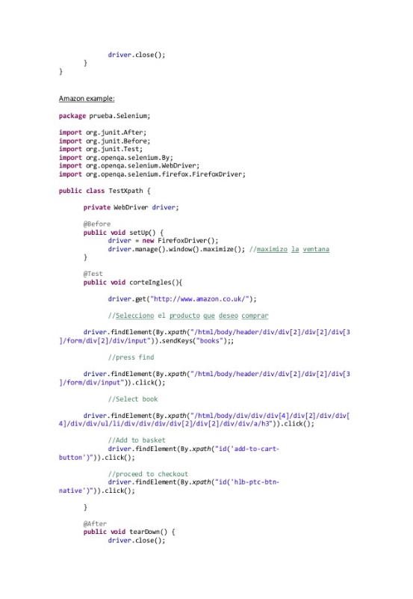


Appium For Mac
A look inside
CocoaHTTPServer
PFAssistive
Framework
macOS
Accessibility
API
JSON
wire
protocol
WebDriver
command
handlers
macOS
mouse/kbd
API
Notes:
PFAssistive Framework CocoaHTTPServer WebDriver command handlers Appium for Mac – a look inside JSON wire protocol macOS Accessibility API macOS mouse/kbd API
The hybrid application • AFM to the rescue! Sort of…. • Copy / Paste / Modify – both ways • The future?? Appium for Mac – a hybrid journey at Intuit

Slide 6
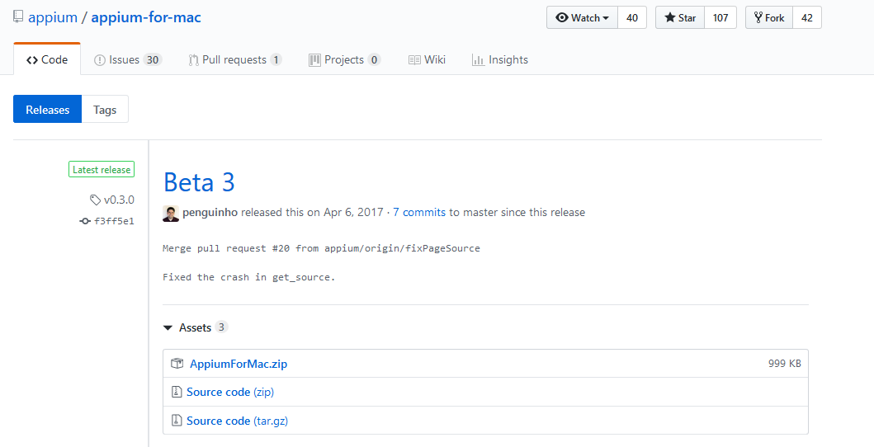
Appium For Mac
Installation
Download a release and unzip (AppiumForMac.zip) the application into your /Applications folder.
Link here: http://appium.io/docs/en/drivers/mac/
Notes:
You can see the new features in the calculator.py example script.

Slide 7
Appium For Mac
Installation
Mac OS X does not allow an application to use the Accessibility API without permission, so you have to enable it manually.
For 10.8:
System Preferences > Accessibility.
Check the "Enable access for assistive devices" checkbox.
Notes:
You can see the new features in the calculator.py example script.

Slide 8
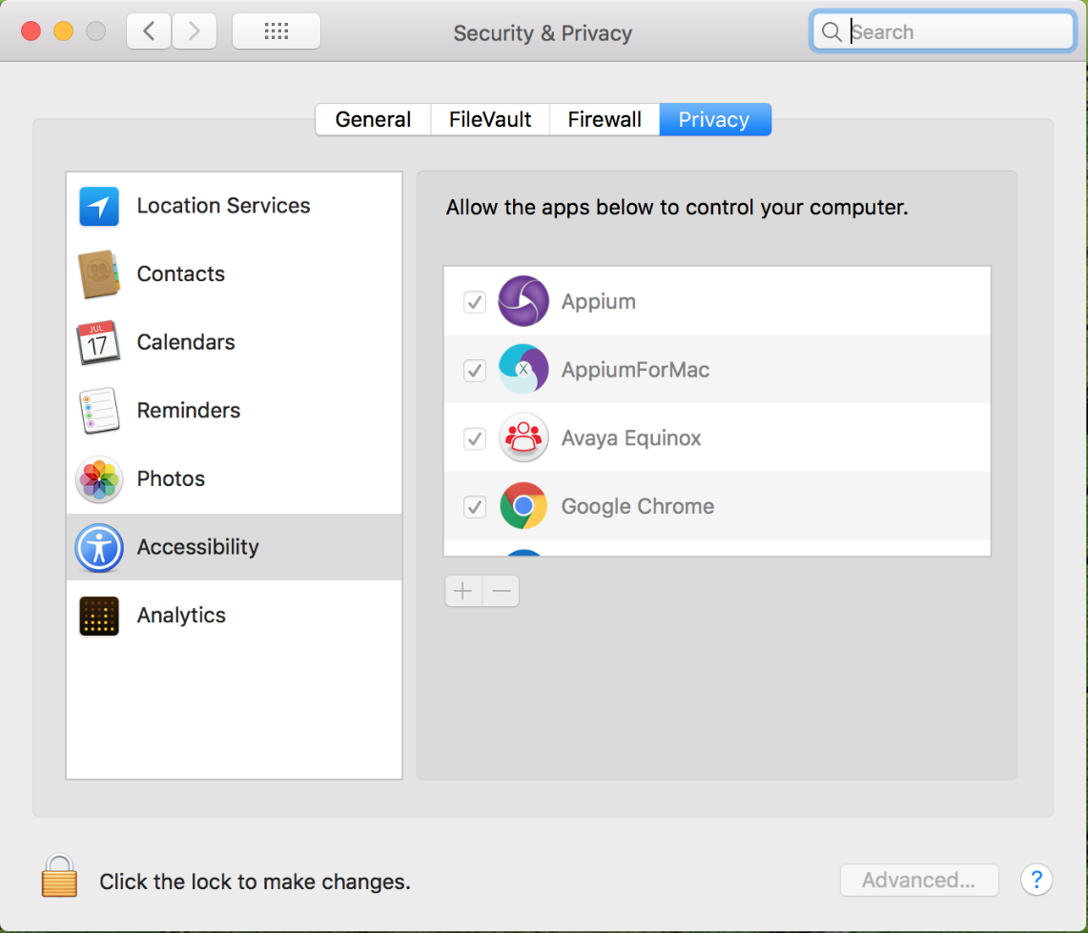
Appium For Mac
Installation
Mac OS X does not allow an application to use the Accessibility API without permission, so you have to enable it manually.
For 10.9 or later:
System Preferences > Security & Privacy.
Privacy tab --> Accessibility.
Check the checkmark next to AppiumForMac.app.
Notes:
You can see the new features in the calculator.py example script.

Slide 9
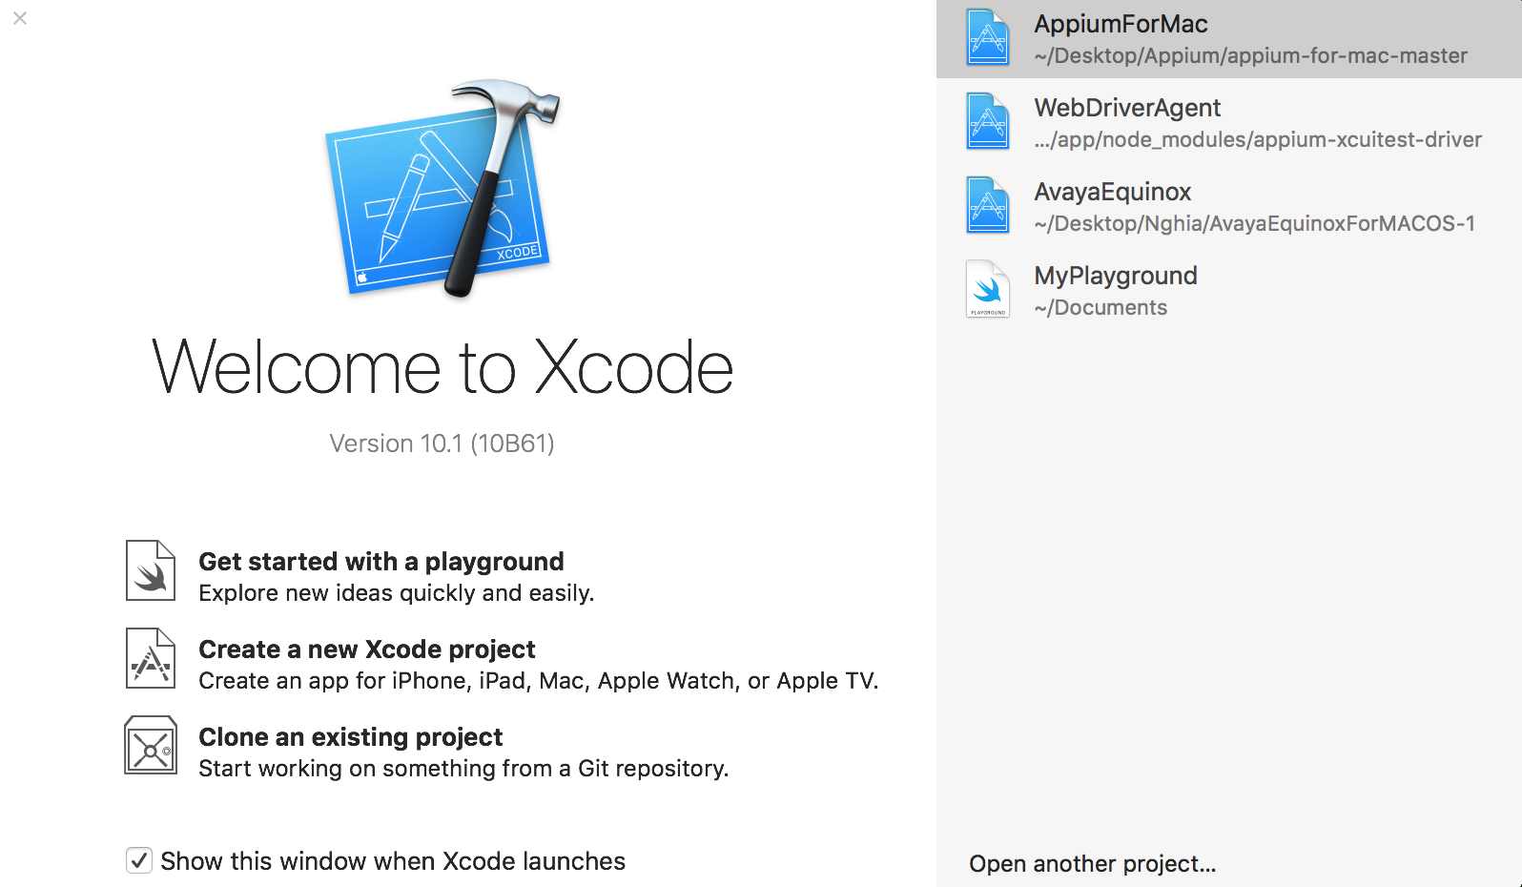
Appium For Mac
Installation
Unzip (appium-for-mac-master.zip) and then building project use Xcode.
Download project: https://github.com/appium/appium-for-mac#installation
Open project ‘AppiumForMac’ and then building use Xcode.
Notes:
You can see the new features in the calculator.py example script.

Slide 10
Appium For Mac
New Features For Scripters
Native Events: AppiumForMac will generate OS X native keyboard and mouse events using Action syntax.
Click.
ActionChains(driver).click(element).perform()
ActionChains(driver).click().perform()
Move to.
ActionChains(driver).move_to_element(element).perform()
Send keys.
ActionChains(driver).send_keys('A string to type.').perform()

Slide 11
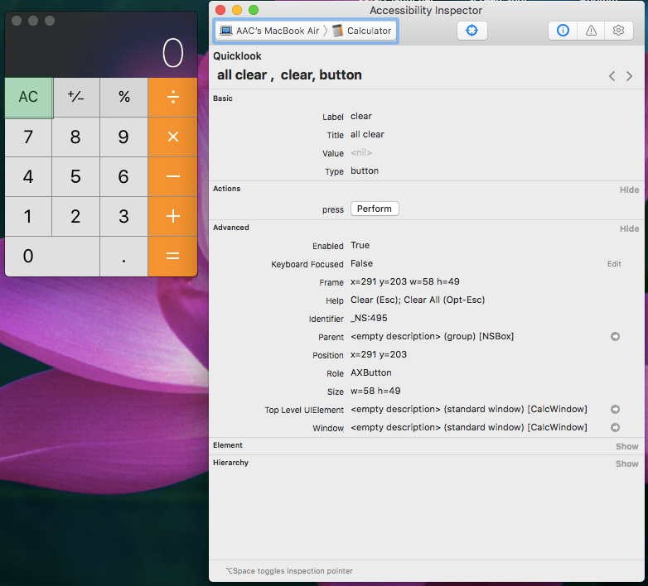
Appium For Mac
New Features For Scripters
Absolute AXPath:
Accessibility Inspector.
Automatic AXPath Recording: press Fn twice on mac.
"/AXApplication[@AXTitle='Calculator']/AXWindow[@AXIdentifier='_NS:477' and @AXSubrole='AXStandardWindow']/AXGroup[@AXIdentifier='_NS:444']/AXButton[@AXTitle='all clear' and @AXIdentifier='_NS:495']"
Notes:
This is a huge performance improvement, although it requires cooperation from the scripter. Instead of using a partial XPath, use a simple absolute AXPath. This is based on the OS X accessibility structure, which you can view in Accessibility Inspector. The paths are "simple" because only a limited subset of XPath syntax is supported. Locating objects by XPath is highly optimized when using absolute AXPaths.
Generating an AXPath for an element is easy: while AppiumForMac is running, just use the mouse to point to an element, then press the fn (function) key for a couple of seconds. AppiumForMac will build the AXPath of the element on screen, and copy it to the clipboard. You can then paste it into your script.

Slide 12
Appium For Mac
driver.add_cookie({'name': 'command_delay', 'value': 2.5})
New Features For Scripters
Absolute AXPath:
New Session Properties: get_cookies, get_cookie(), and addCookie().
To get all cookies, use driver.get_cookies().
To get one cookie, use driver.get_cookie('cookieName').
To set a cookie, use driver.add_cookie({'name': 'cookieName', 'value': 'cookieValue'}).
Ex:
driver.add_cookie({'name': 'mouse_speed', 'value': 200})
driver.add_cookie({'name': 'command_delay', 'value': 2.5})
More feature:
https://github.com/nmdong/robotframwork/tree/master/appium_for_mac
Notes:
Each cookie is a dictionary with at least two keys: 'name' and 'value'. The Selenium commands are: get_cookies, get_cookie(), and addCookie().
Implicit Timeouts
AppiumForMac supports standard implicit timeouts when finding an element. The default is 0.0 seconds, that is, there will be only one attempt.
For example, to set a 20.5 second timeout, use driver.add_cookie({'name': 'implicit_timeout', 'value': 20.5}).

Slide 13
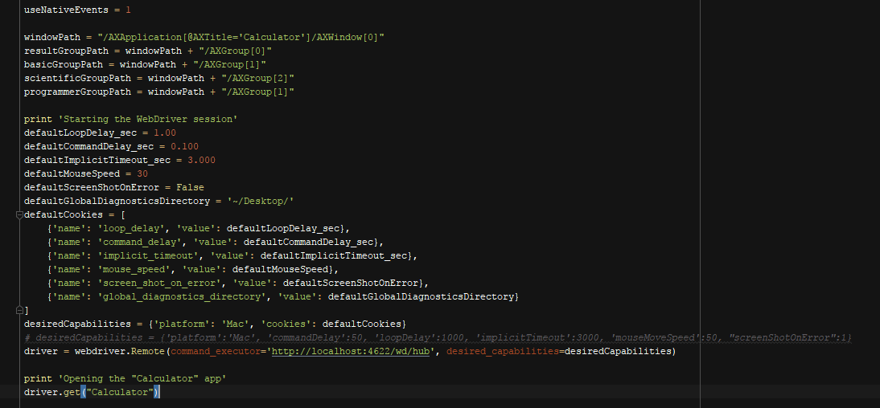
Sample test
Sample test 1
Notes:
On yours mac, we need go to folder \examples and run python file (sample_test_calculator.py) and get result.
Before execute, you should be check your python and appium for mac on yours mac.
NOTE: The WebDriver server is on port 4622. If you build it yourself, you can change this value in AppiumForMacAppDelegate.m.

Slide 14
Sample test
Sample test 2
Go to appiumformac\examples\Sample_Test_Run_Local_Mac
Take a look on this sample test (sample_test_calculator.py)
Execute and observe the results
Notes:
On yours mac, we need go to folder \examples and run python file (sample_test_calculator.py) and get result.
Before execute, you should be check your python and appium for mac on yours mac.
NOTE: The WebDriver server is on port 4622. If you build it yourself, you can change this value in AppiumForMacAppDelegate.m.

Slide 15
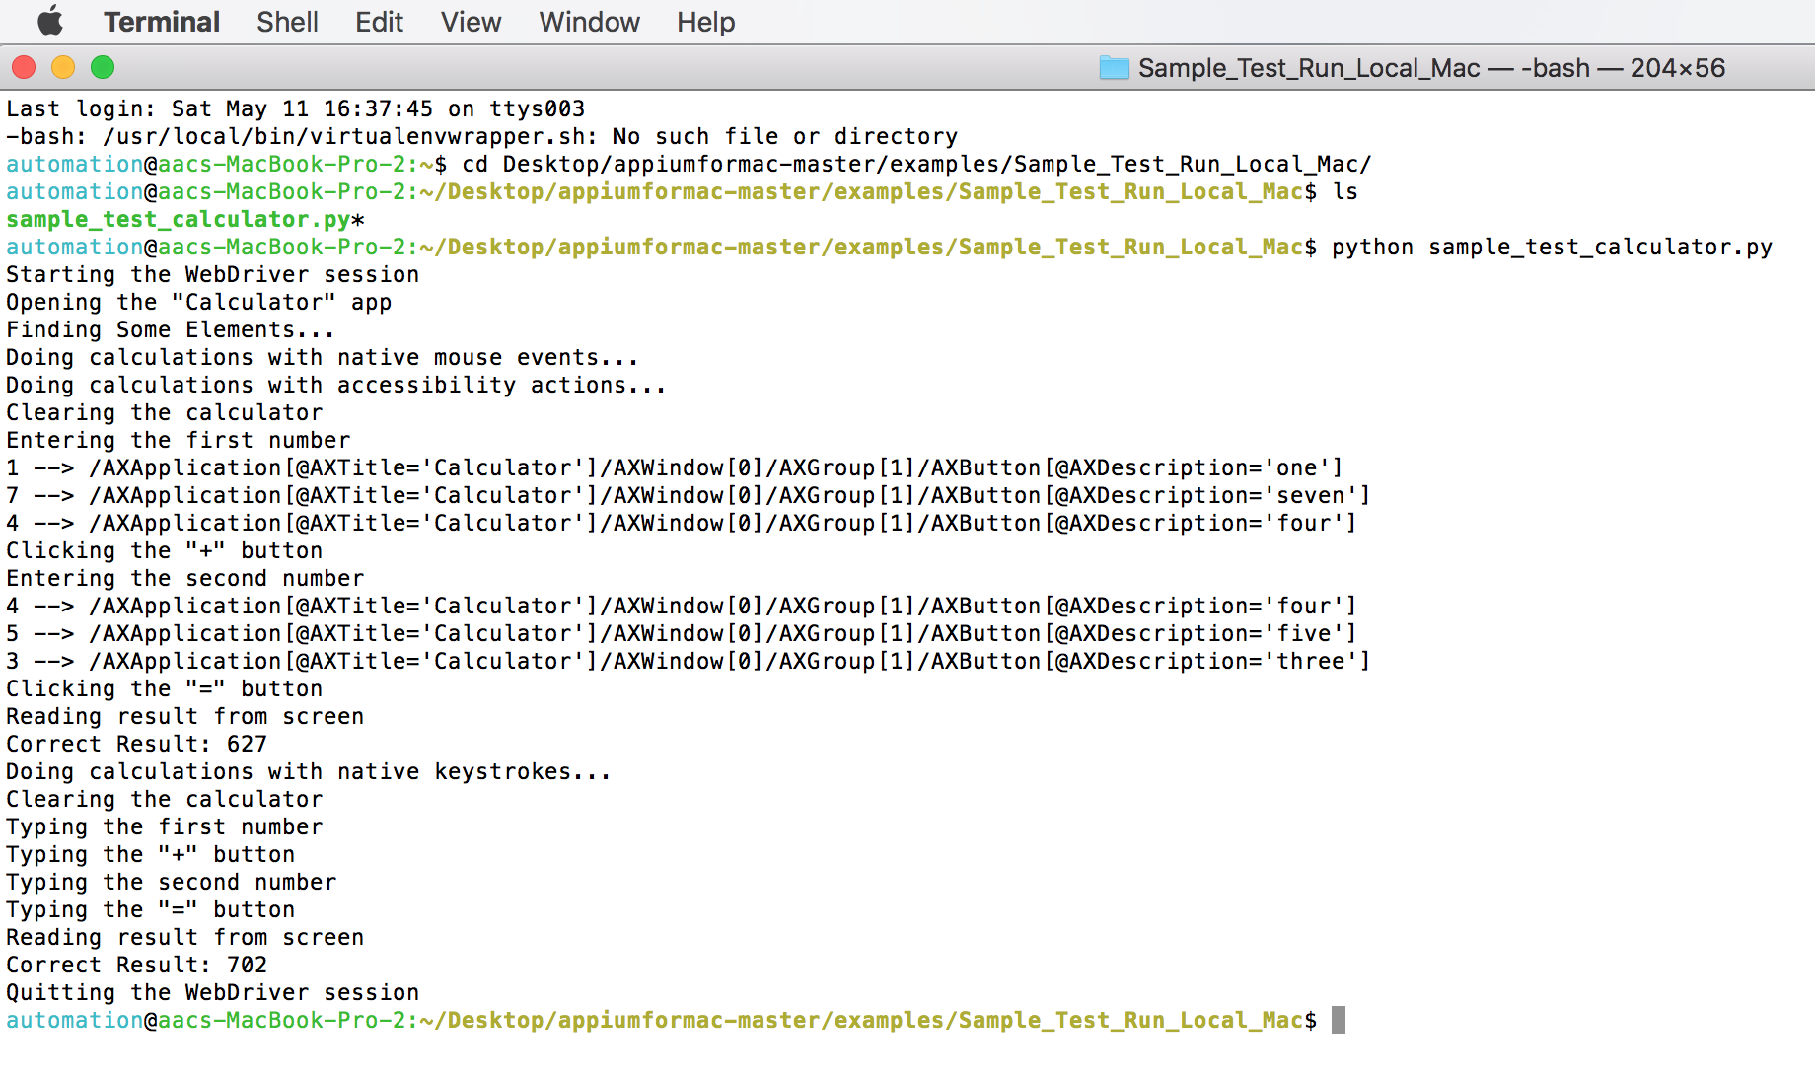
Sample test
Sample test 2
Notes:
On yours mac, we need go to folder \examples and run python file (sample_test_calculator.py) and get result.
Before execute, you should be check your python and appium for mac on yours mac.
NOTE: The WebDriver server is on port 4622. If you build it yourself, you can change this value in AppiumForMacAppDelegate.m.

Slide 16
Robot Framework
How to develop Functions/TCs/TestSuite
Installing Required Software.
Setup Pycharm Community Edition.
Install python 2.7.x or 3.x.
Configuring Pycharm to run TCs robot.
Project Structure.
UI Page.
Test Methods.
Test suite - Test case in Robot FrameWork.
Log File in Robot FrameWork.

Slide 17
Robot Framework
How to develop Functions/TCs/TestSuite
Installing Required Software.
Setup Pycharm Community Edition.
Install python 2.7.x or 3.x.
Configuring Pycharm to run TCs robot.
Project Structure.
UI Page.
Test Methods.
Test suite - Test case in Robot FrameWork.
Log File in Robot FrameWork.

Slide 18

Robot Framework
Installing Required Software.
Setup Pycharm Community Edition.
Go to https://www.jetbrains.com/pycharm/download/#section=windows.
Download PyCharm community edition.
While installing, make sure to have following options checked.
Setup Pycharm Community Edition

Slide 19
Robot Framework
Installing Required Software.
Install python 2.7.x or 3.x.
Go to following link: https://www.python.org/downloads .
Install python and make sure that python is in environment variables.
Install robotframework.
Using pip: pip install robotframework

Slide 20
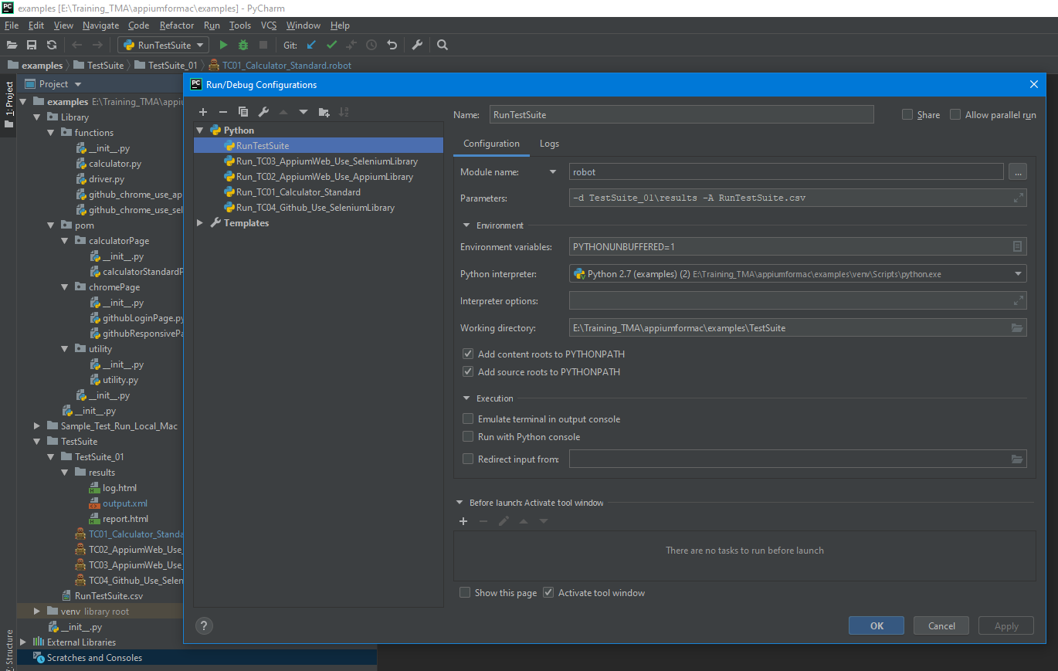
Robot Framework
Installing Required Software.
Run TCs robot in Pycharm.
Testsuites Name
Click on ‘+’ to create new configuration
Choose ‘Module name’ and write ‘robot’
The name of the robot file you want to run
The python interpreter which will be use
Working Directory, this should be the path where you robot file resides
Notes:
Then the following window will open. In the edit configurations window, setup as per following image to set up run configuration
Once you are done with run configuration, it will appear in pycharm window and you can run it from PyCharm by clicking play butto

Slide 21
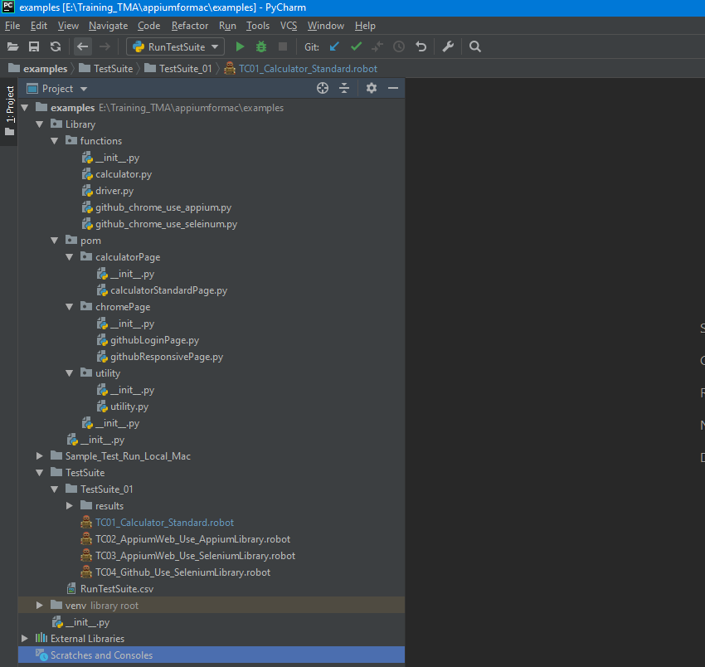
Page Object Model (POM)
Project Structure
Test Methods
Project demo

Slide 22
Page Object Model (POM)
Project Structure
All UI page for POM classes
Project demo

Slide 23
Page Object Model (POM)
Project Structure
Test suite - Test case
Project demo

Slide 24
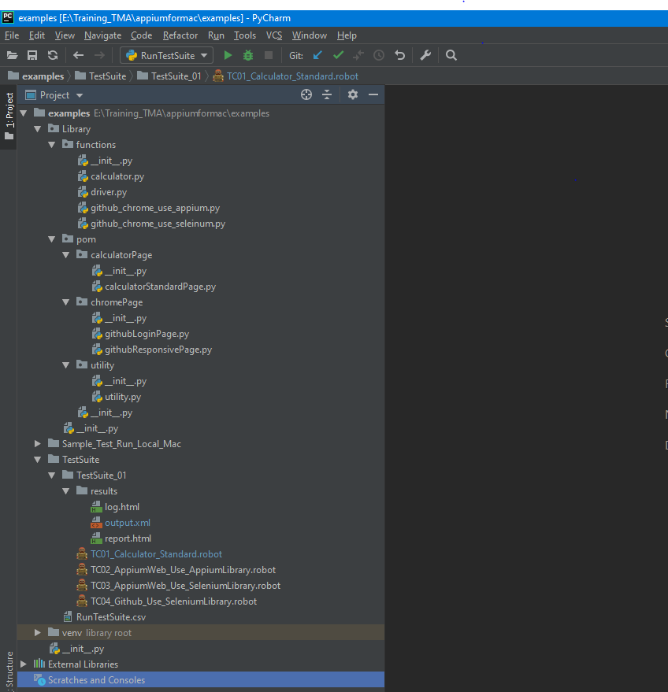
Page Object Model (POM)
Project Structure
Log File in Robot FrameWork
Project demo

Slide 25
Page Object Model (POM)
Sample test
Go to Robot_web_tesing > pom and sample_suite
Take a look on test scripts
Execute and observe results

Slide 26
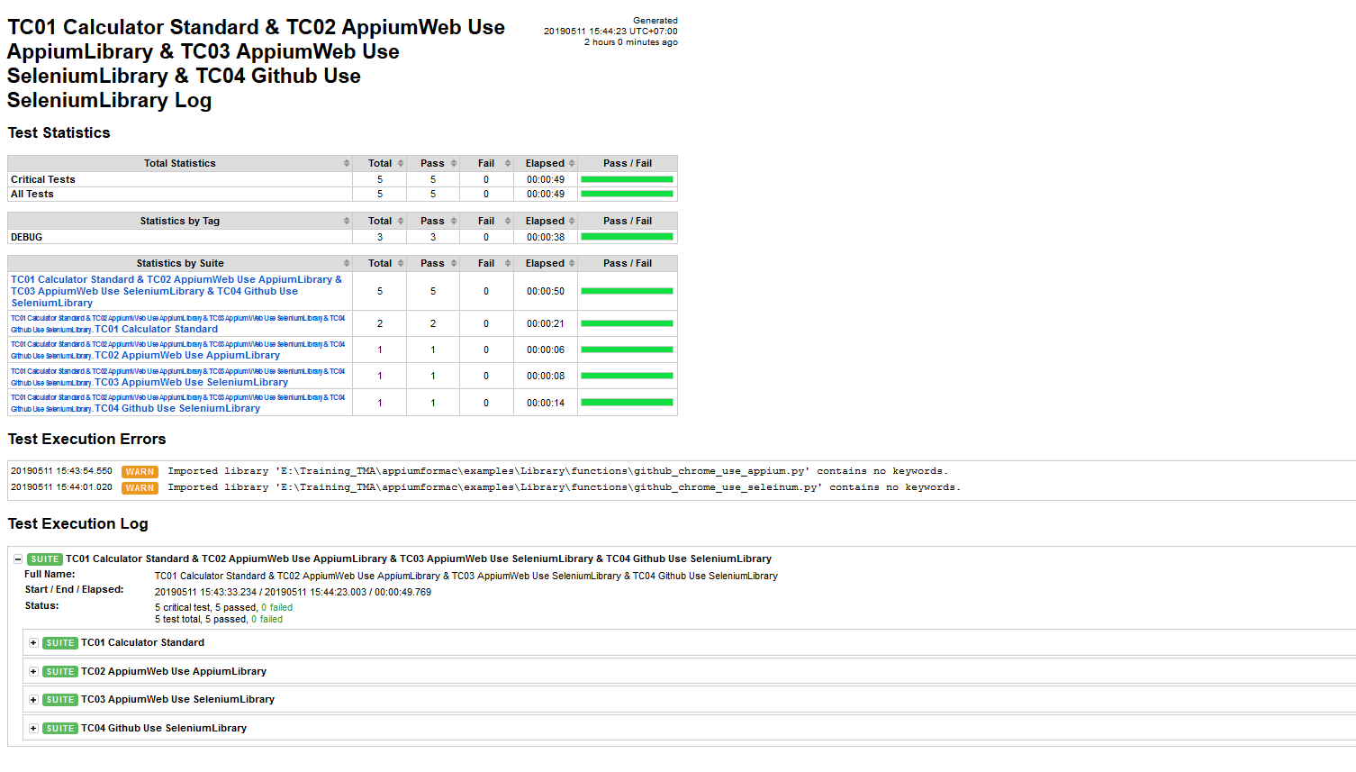
Page Object Model (POM)
Sample test

Slide 27

Robot Framework
Q&A

Slide 28

THANK YOU !
Tel:
Mobile:
Fax:
Email:
+84 8 3997-8000
+84 908-676-212
+84 8 3990-3303
sales@tmasolutions.com
North America number:
Australia number:
Japan number:
Website:
+ 1 802-735-1392
+ 61 414-734-277
+81 3-6432-4994
www.tmasolutions.com

